Slide 1
General meeting
01.12.2022

Slide 2
Motivations
I want to go over the work that has been done, how things have changed and challenges I’ve met along the way.

Slide 3
Contents
Recap what has been done this semester
Evaluate what has been good/bad/quick/slow
The way forward

Slide 4
Recap

Slide 5
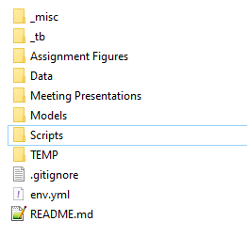
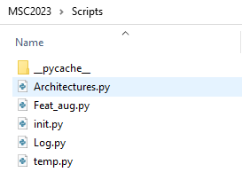
Early phase
Period from 22.08 to 23.09
Created the github repository and organized a folder structure
Established the code for the TCN architecture
Robust to the changes I was looking to make in the data
Created a initialization script which runs the algorithm of a given architecture
Log.py contains necessary functions to create logs of the model run
Feat_aug.py has all functions related to manipulating the input data. Also things that are not strictly feature augmentation such as loading the data.

Slide 6
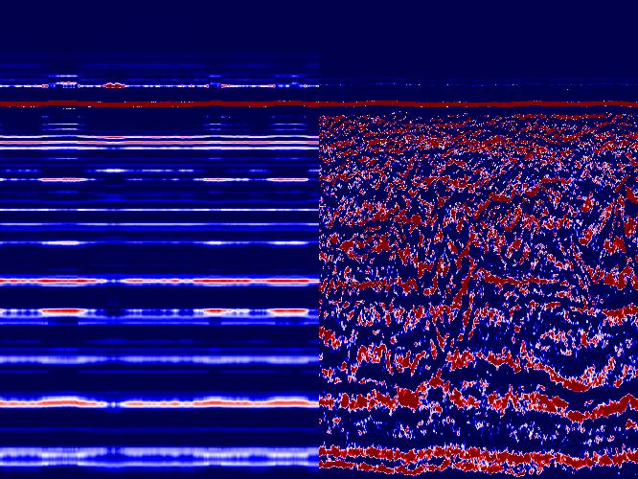
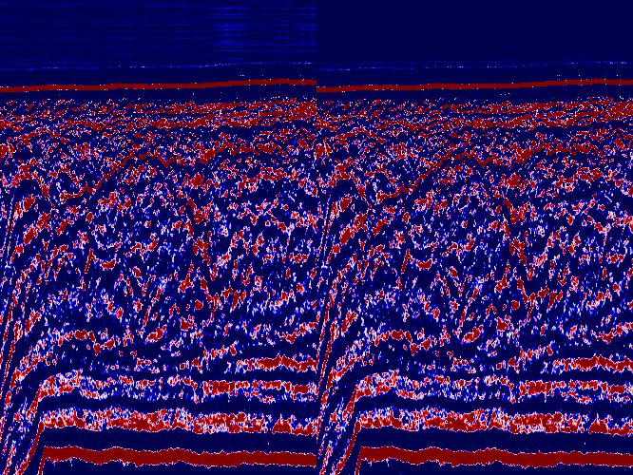
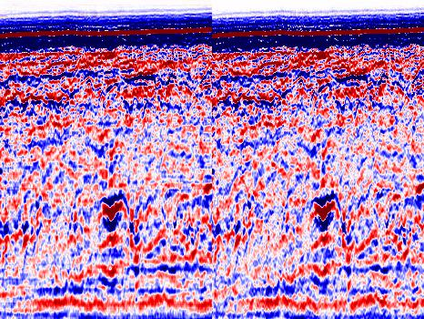

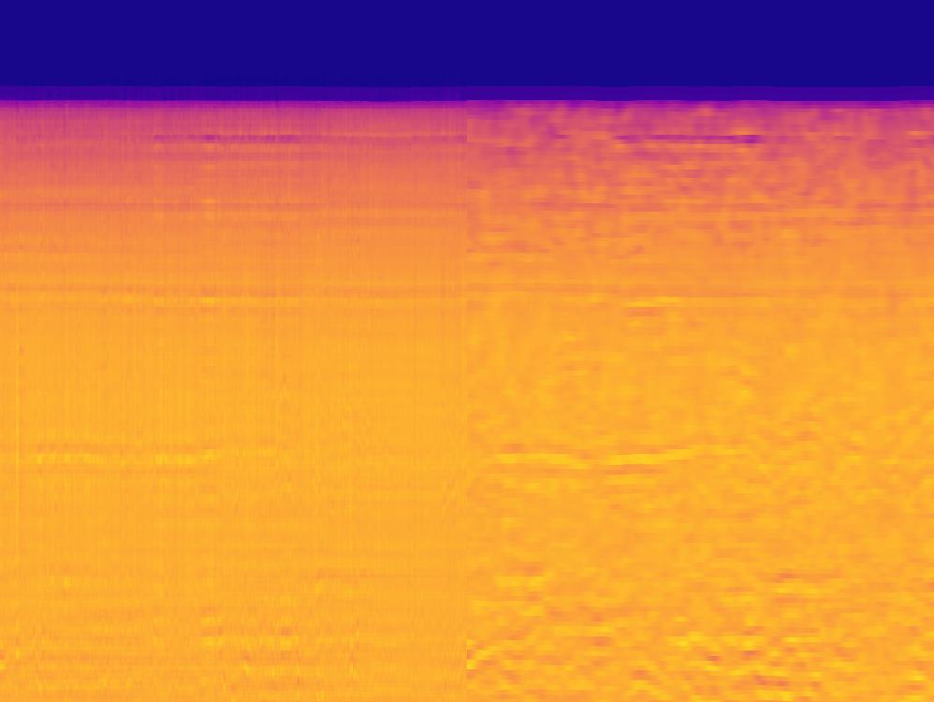
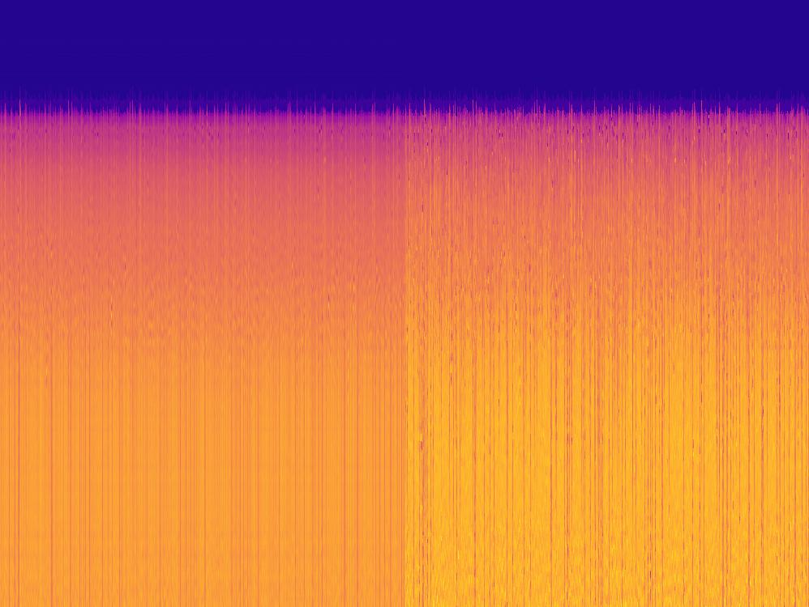
Midterm phase
Normalization
23.09 to 16.11
Debugging and running models
Trying to overfit, then peel back (although still including dropout layers)
Dataset preparations
First small, used for debugging
Later expanded
ML architecture is still only 1D…

Slide 7
Late phase
17.11 to current time
Cardinality issue
Matching traces got fixed
Using exhaustive dataset and shuffling
Omitting dense activation layer at the end (only able to do for reconstruction)
Properly debugging a 2D implementation requires good methods for data treatment
Robust running algorithms and evaluating the parameters for AI inversion task in 1D

Slide 8
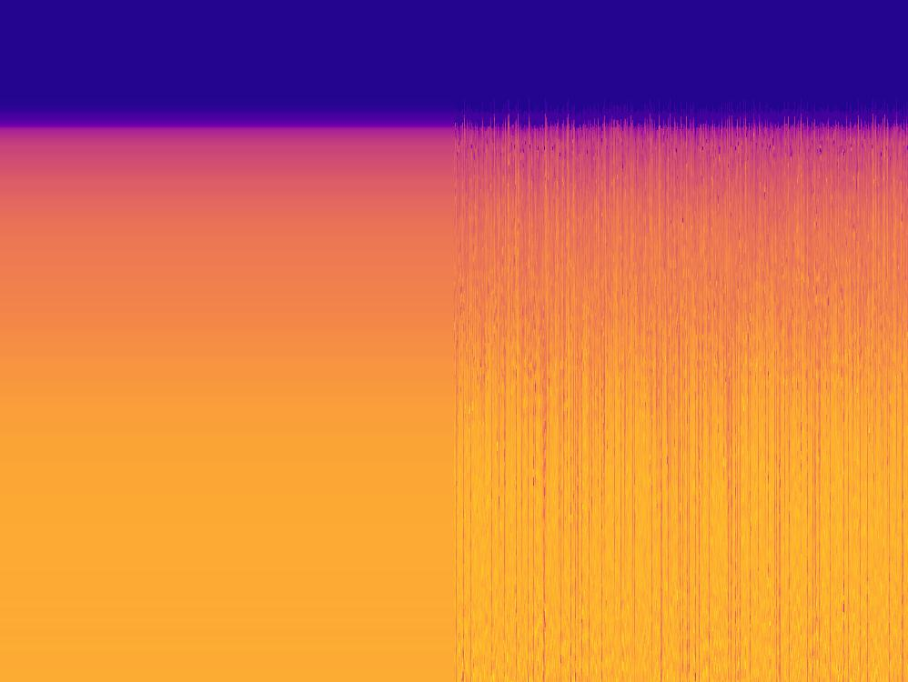
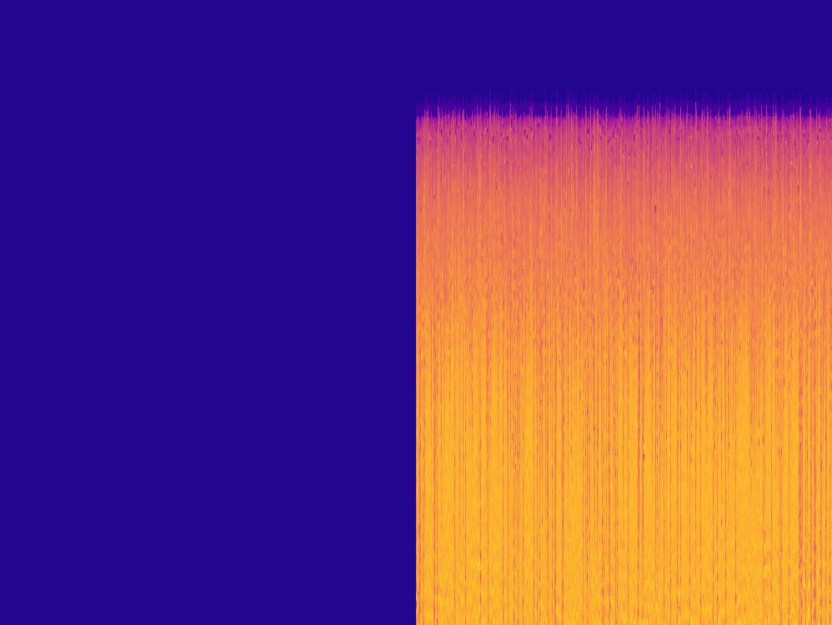
Problems..
Still having the averaging problem
Sometimes the model just completely gives up..
I think both these issues can be solved by proper data prep
Shape issue for regression predictions
Might have to resample the AI
Shape issue for 2D TCN

Slide 9
Going forward
Starting to implement CPT prediction (outputs) and seismic attributes (inputs) to the model runs
Also implementing robertson classification task
Tensorboard image visualization
I’m going to select certain features from the dataset, and tensorboard will show how the feature maps look at the different stages.
The features will get selected based on geological facies.
Matching CPT to seismic and writing funciton for extracting seismic data near a borehole
WRITING!

Slide 10
Updated Goals
Compare prediction results of following approaches, all predicting CPT also:
1D TCN with regression & reconstruction
1D TCN with regression & reconstruciton using spatial info from seismic attributes
2D TCN with regression & reconstruction
1D TCN with Robertson classifyer
2D TCN with Robertson classifyer
Comparisons will be done based on:
Model performance accuracy and loss
Ability to capture spatial features
Quality of predictions within certain features
Do in between seismic lines geostatistical predictions

Slide 11

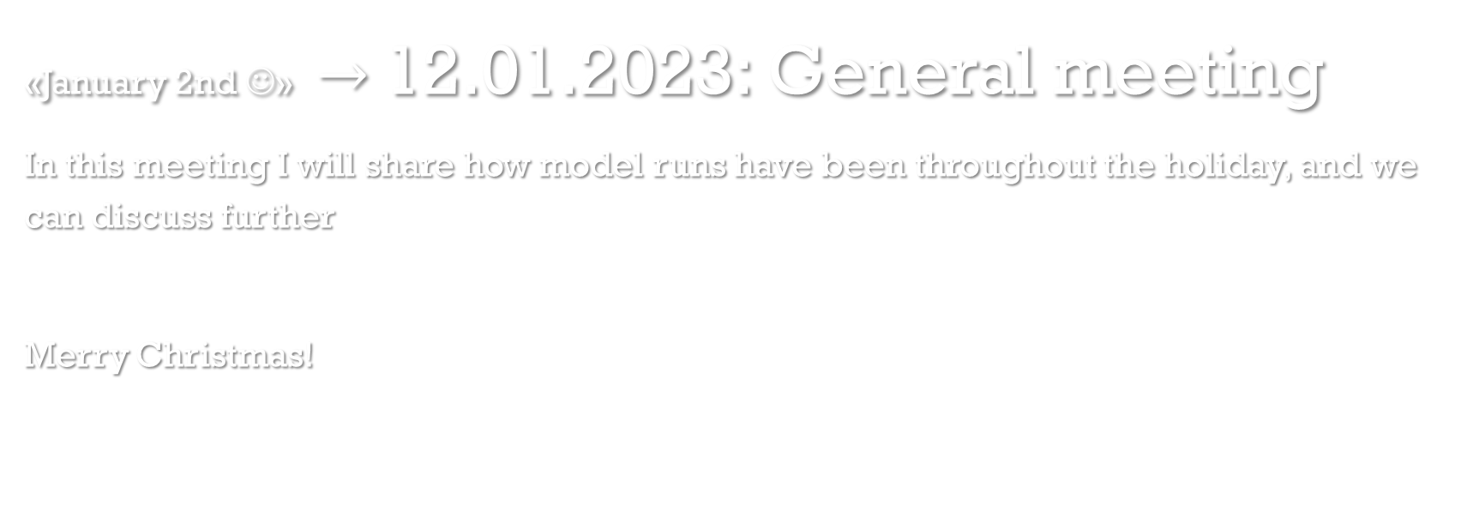
Next meeting
«January 2nd ☺» $→$12.01.2023: General meeting
In this meeting I will share how model runs have been throughout the holiday, and we can discuss further
Merry Christmas!

